Slide 1
DeepPysch

Slide 2

Action plan
Optimal Architecture search – structural parameters, layout of model
Hyperparameter optimisation
Inter-model variability/comparison

Slide 3

Architecture search
Determining the best layout of particular models know for classification (e.g. Known/customary CNN, RNN-LSTM)
Training model on the data separately or collectively?

Slide 4
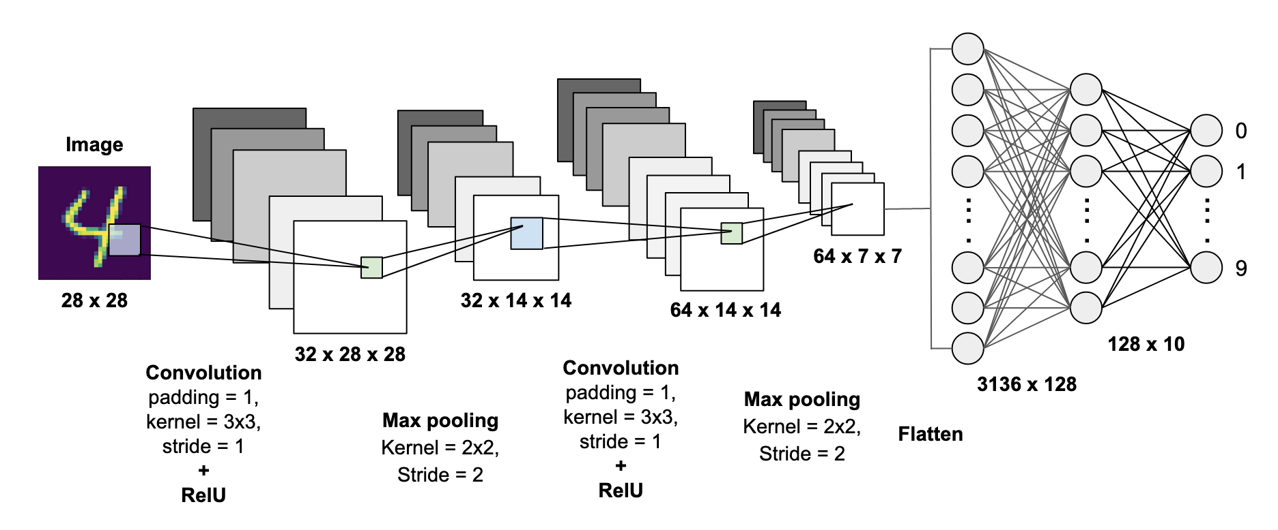
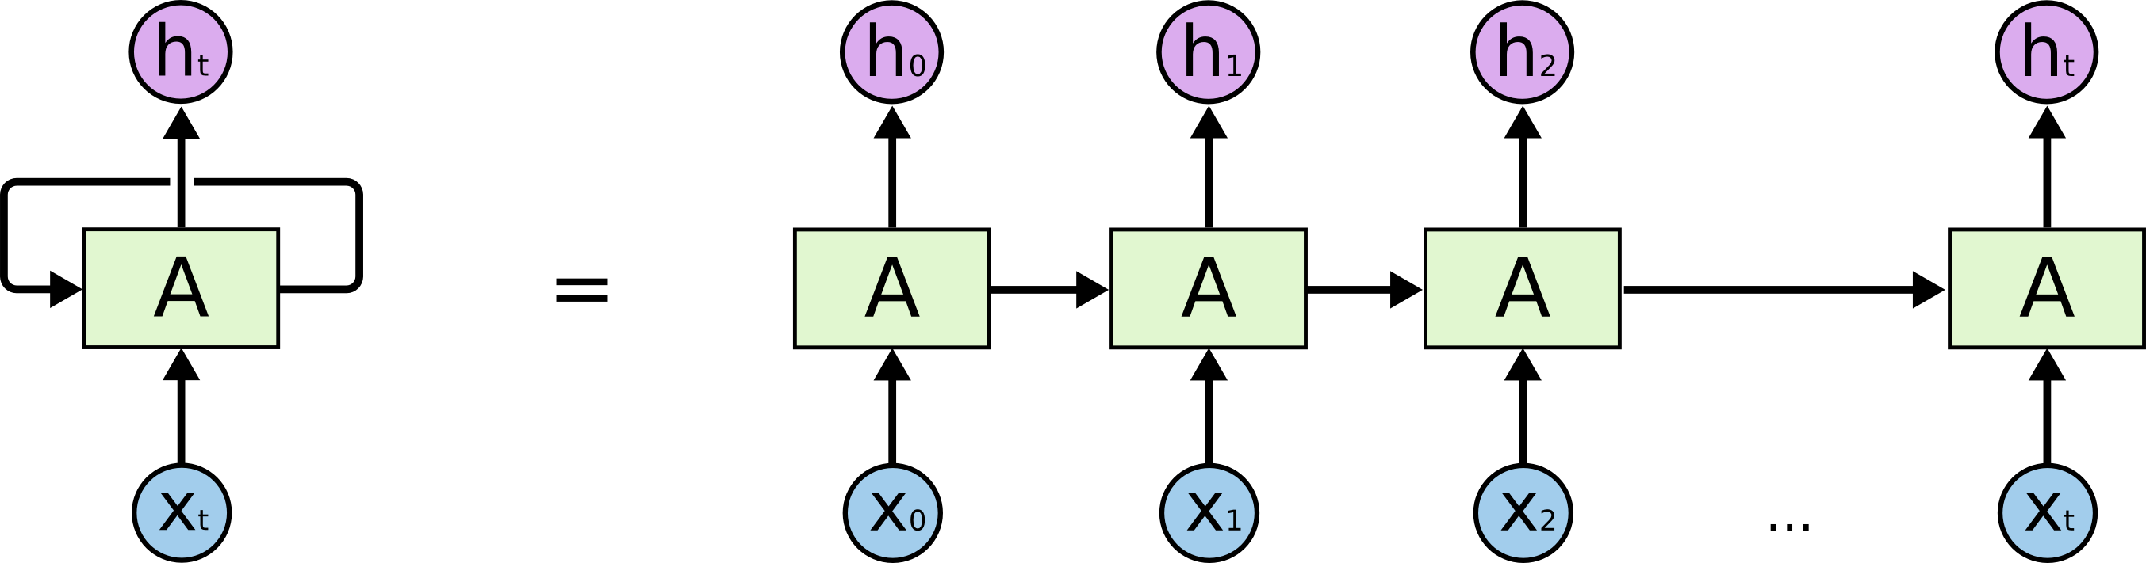
Models Tested
Convolutional Neural Networks:
DeepSea variants (archi parameter variance)
Resnet18, 32 variants
Custom designs
Recurrent Neural Networks:
Long/Short term memory models

Slide 5
Single model Vs separate models
Data Category | Single Model performance (TPR, ROC) | Separate model performance (TPR, ROC)
Cage | Was not ready… | 74 76.8
TF | 11.5 70.9 | 26.1 85.5
HumanFC | 42.1 91.2 | 66 86.5
Epimap | 51.4 84 | 64 76.1

Slide 6
Chromosome-wise Tests
Model Comparison
Tests (on all 3 cr’s)
Optimisation Tests
Exp1
Exp2
Exp3
Exp4
Exp5
Exp6
Exp7
Exp8
Exp9
Cr_09
Cr_19
DeepC
Rnn
Cage
HumanFC
Epimap
TF
Done
In progress

Slide 7
Model Comparison – DeepPysch Vs DeepSea
Epimap

Slide 8
Model Comparison – DeepPysch Vs DeepSea
HumanFC

Slide 9
Model Comparison – DeepPysch Vs DeepSea
Cage

Slide 10
Model Comparison – DeepPysch Vs DeepSea
TF

